Slide 1


User Manual for PRASHAST 2.O web application
School Education Department
Samagra Shiksha –Tamil Nadu
Created on : 06.07.2026

Slide 2
PRASHAST 2.0
It is an upgraded mobile and digital platform developed by NCERT under the Ministry of Education. It enables teachers and school administrators to screen and identify 21 types of disabilities in children to improve early intervention, support services and the disability certification process.

Slide 3
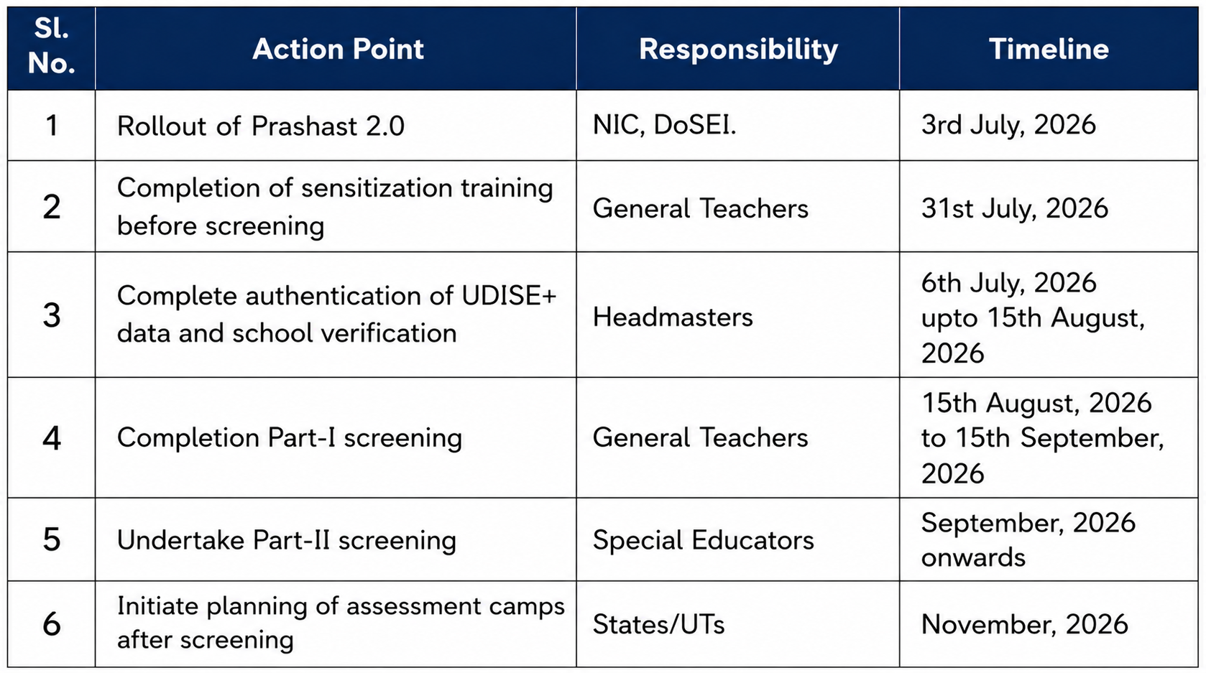

Slide 4
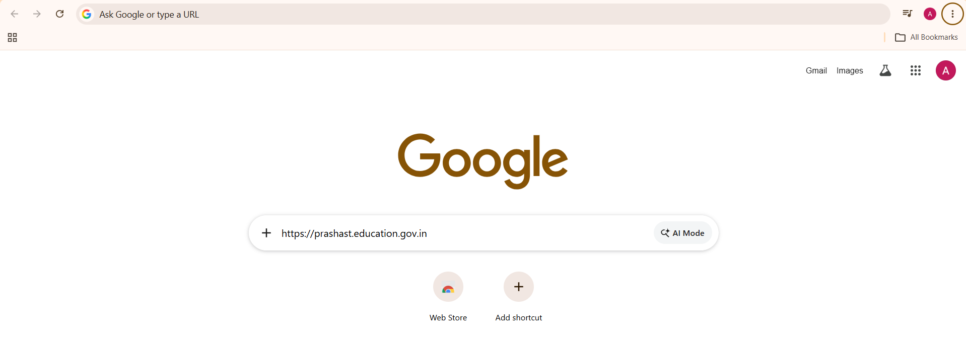
Step 1: Open the Website
Open a web browser (e.g., Google Chrome).
In the address bar, type https://prashast.education.gov.in and press Enter.
The PRASHAST homepage will load, displaying the platform’s introduction and navigation menu.

Slide 5
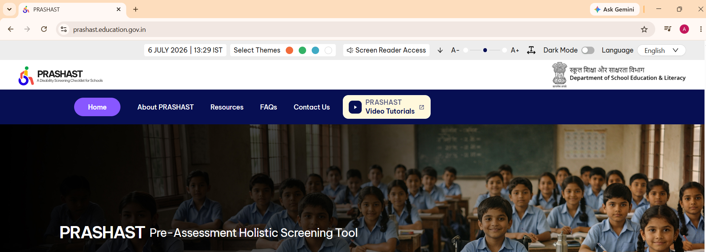
Step 2: Access the Login Page
Click on the PRASHAST Video Tutorials button on the homepage. This redirects to the login interface.

Slide 6
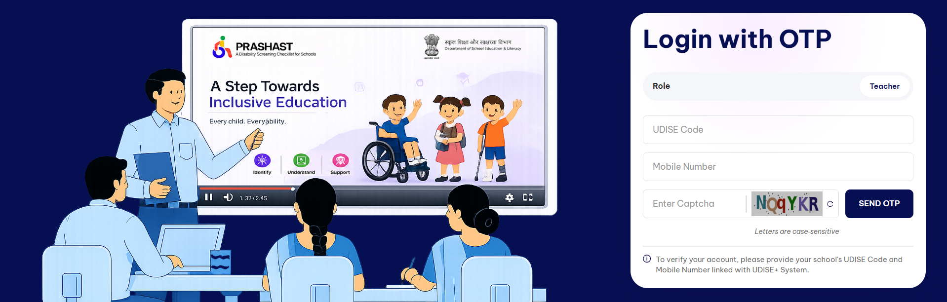
Step 3: Enter Login Details
Enter the School UDISE Code
Enter the Mobile Number which is registered in the UDISE+.
Enter the Captcha shown in the captcha box.
Click Send OTP to receive a one-time password on the registered mobile number.
Enter the OTP received and click Login to access the tutorial dashboard.

Slide 7
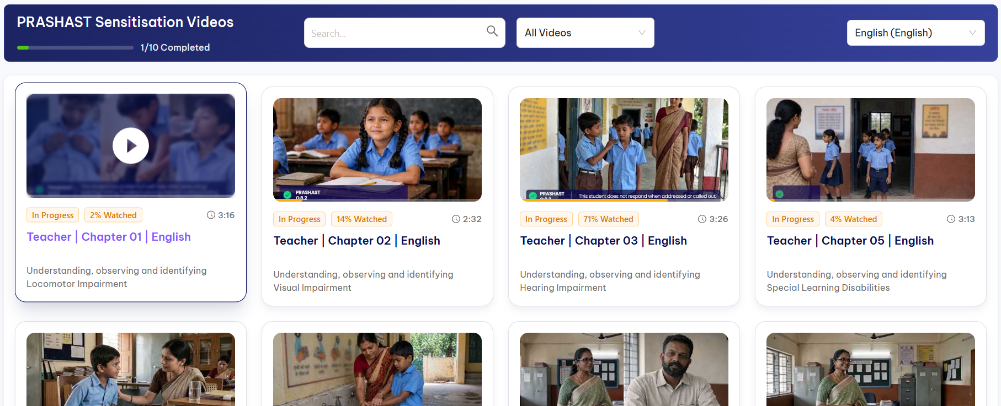
Step 4: View All the Videos
Click the Play button on the video thumbnail, as shown in the image, to watch the guidance video and understand how to observe, identify and assess the disability of each student.

Slide 8
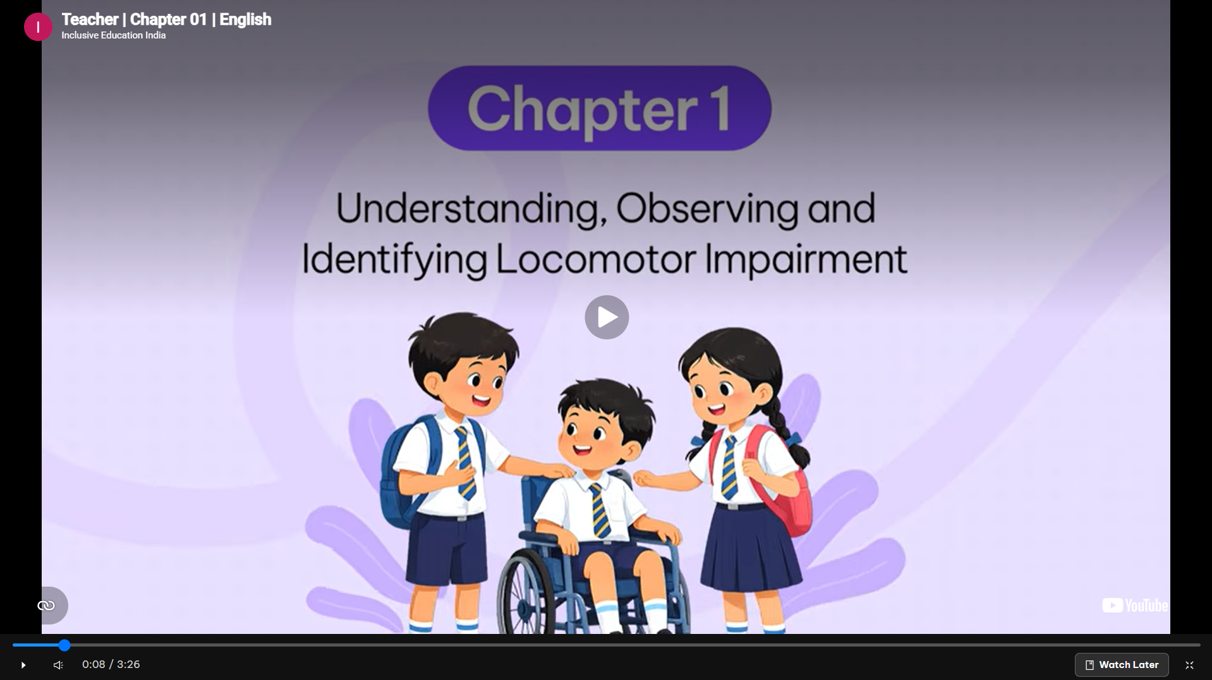
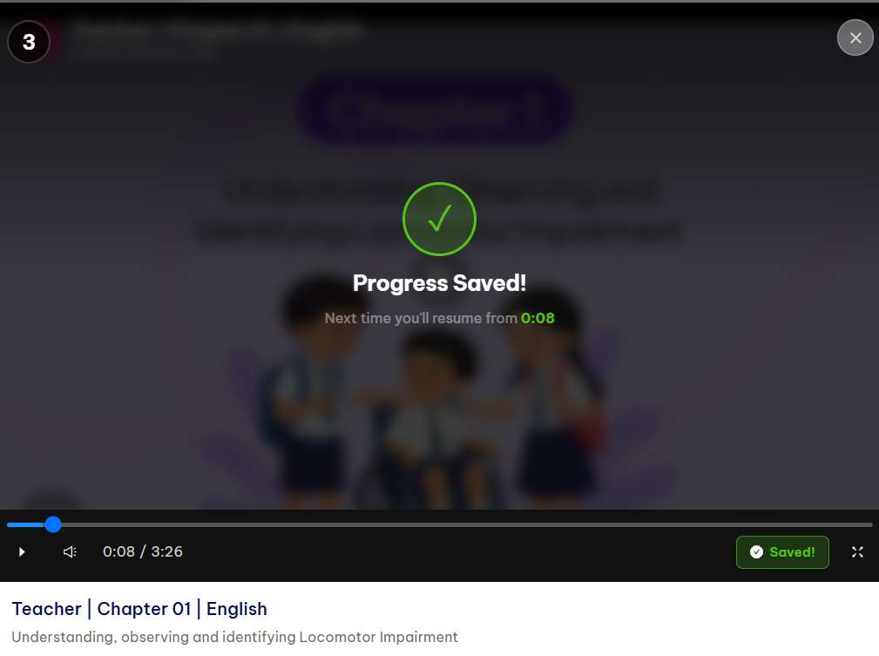
Once the user has watched all the videos, they will be allowed to proceed to the assessment.
Once the user has watched all the videos, they will be allowed to proceed to the assessment.
Progress Tracking
The system automatically saves progress.
A message appears: “Progress Saved! Next time you’ll resume from 0:08.”
Completed videos are marked with a green Completed label.
Watch the full video without break for better understanding.
Once the user has watched all the videos, they will be allowed to proceed to the assessment.

Slide 9
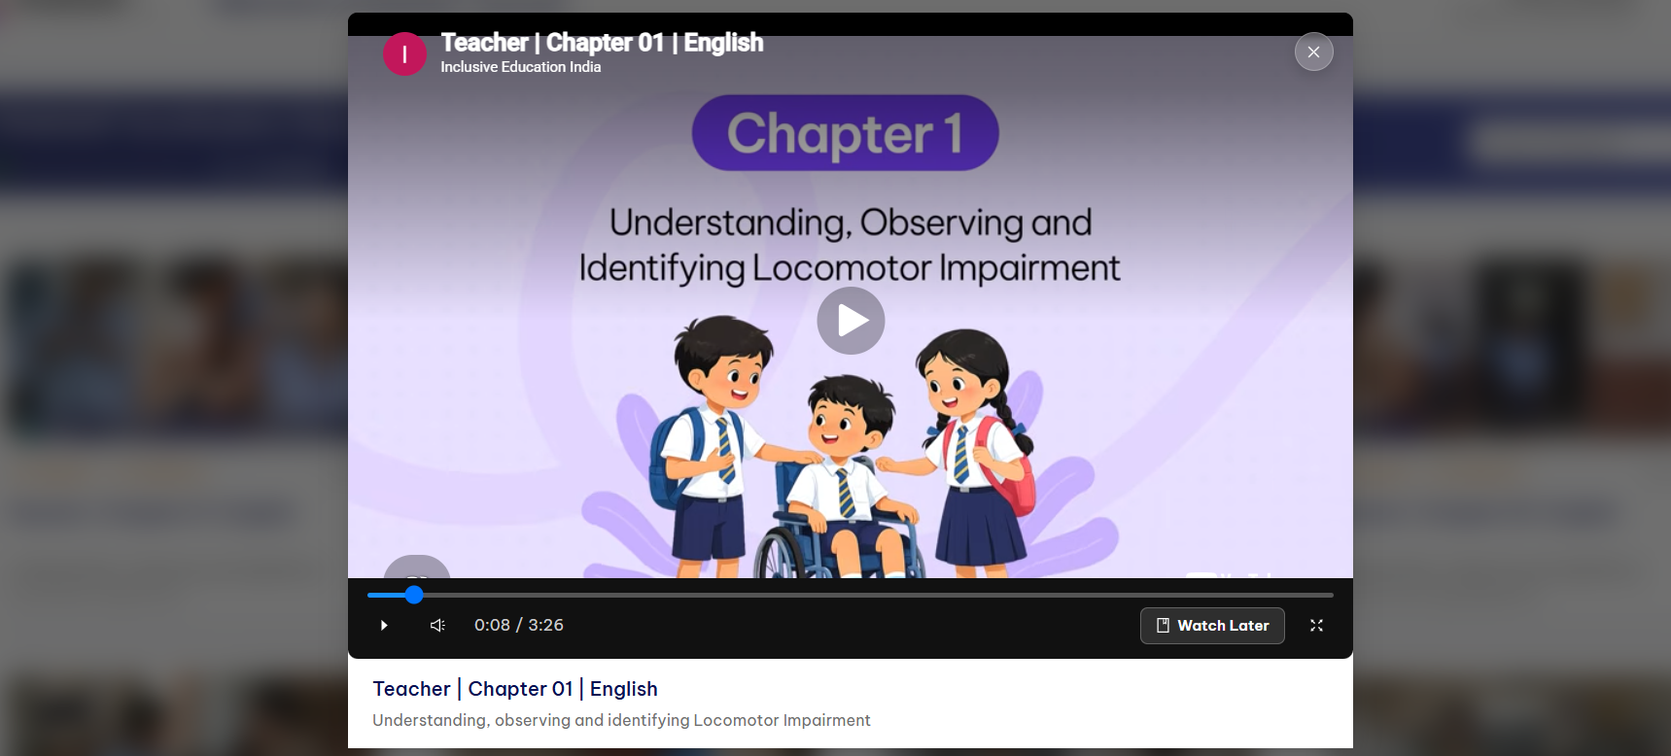
Step 5:
Click the Maximizer button in the Screen to play the video in full screen mode.

Slide 10
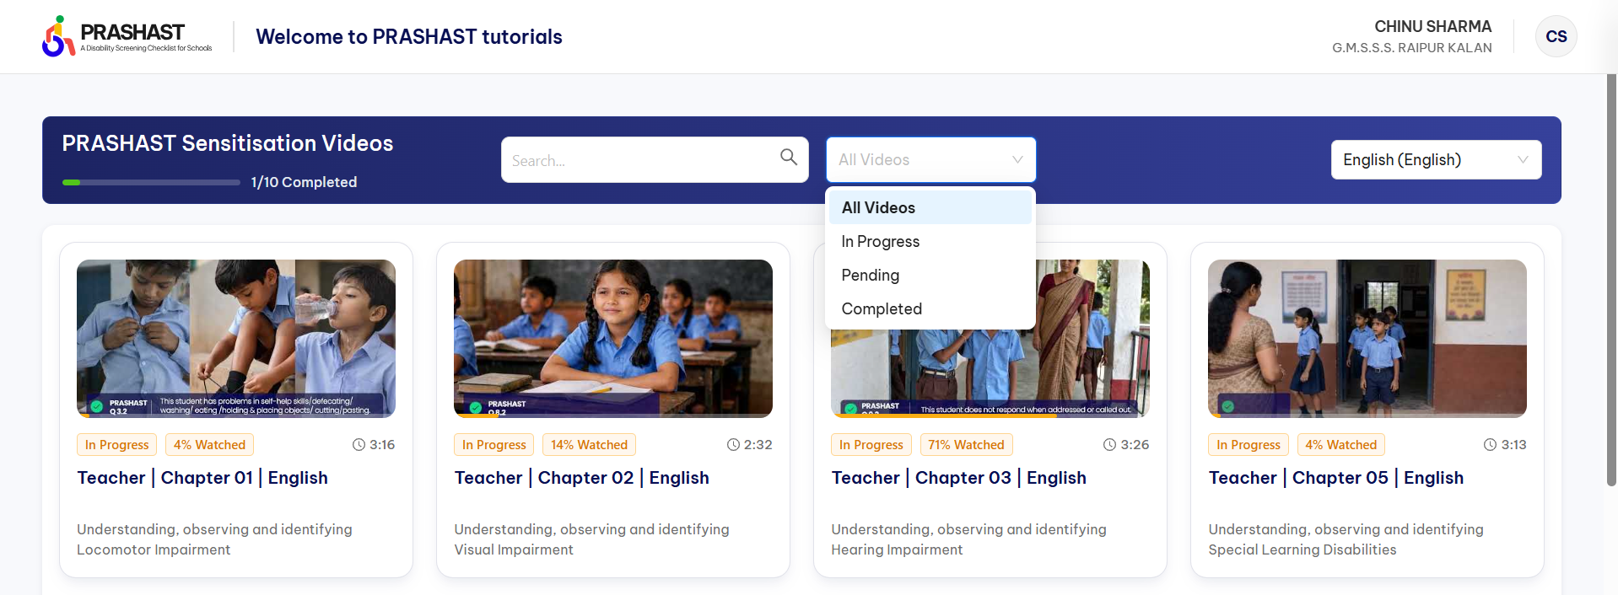
Note : To track your Progress by Status Filter
Use the dropdown menu to view videos by status:
All Videos: Displays all available tutorials.
In Progress: Shows videos partially watched.
Pending: Lists videos not yet started.
Completed: Displays videos fully watched

Slide 11
Thank You

