Slide 1
Steps to Update
EMIS number for
Pre-Matric (9th & 10th ) and
Post-Matric (+1 & +2)
The EMIS number should be Unique.

Slide 2
How to update EMIS number in our Scholarship web portal
Steps | Process
The EMIS number is Unique.
1. | Institution need to login with their login credentials in our school web portal
2 | Click on Scholarship Menu.
3. | Complete renewal process by Clicking Renewal-(Sch.Applcaitions) 3.1.Click on Course Name. 3.2.Select all and 3.3.Click on Renew button to complete the process.
4. | Click on EMIS Number(new) sub menu.
5. | Select Post-Matric or Pre-Matric radio button
6. | Select the Check box then update the EMIS number for each and evey students one by one by clicking Update EMIS number button
7. | After updation of EMIS number, the students applcaition will be reflected in the Principal login for Submit.

Slide 3
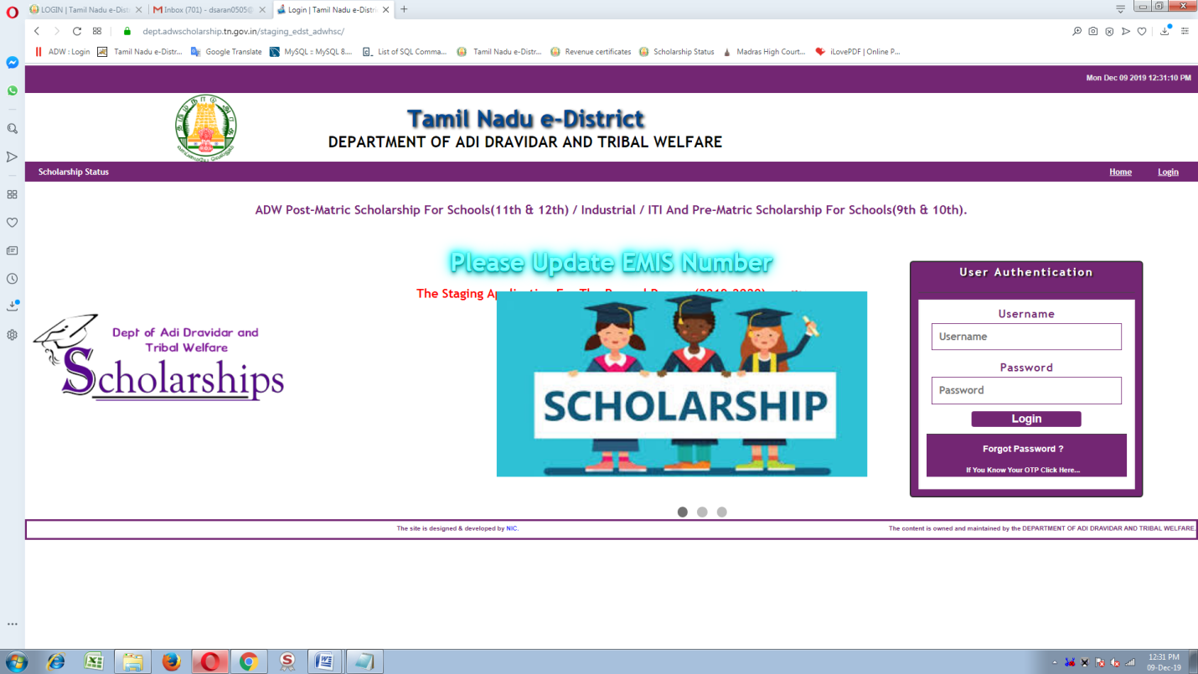
Institution need to login with their login credentials in our school web portal

Slide 4
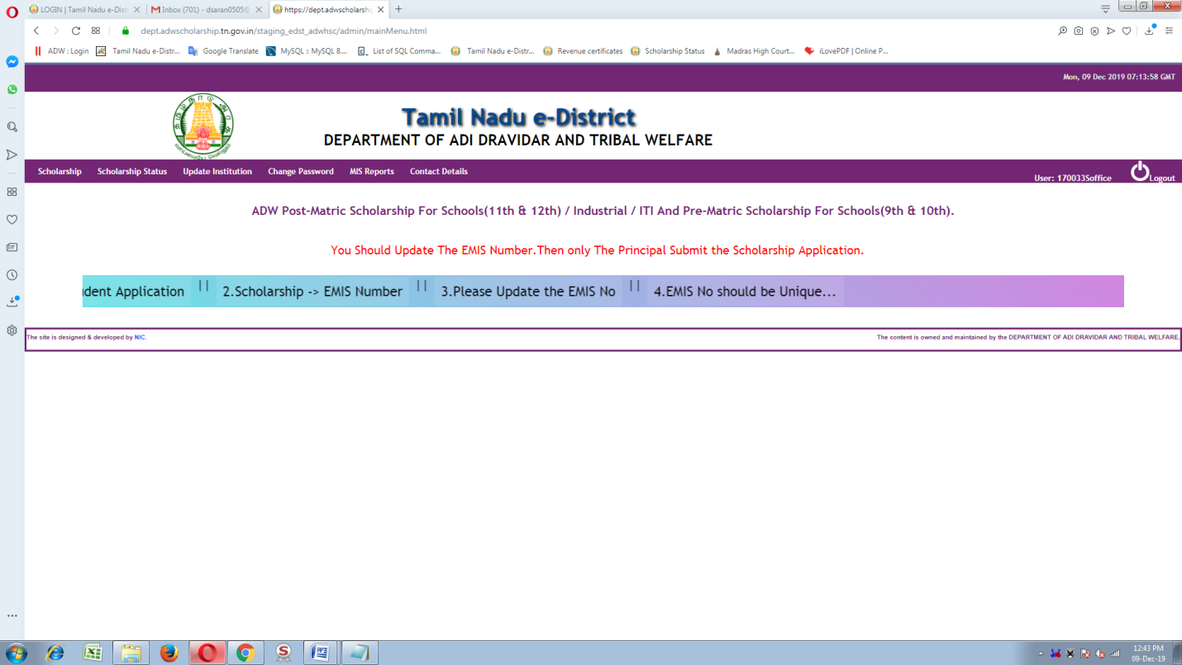
Click on Scholarship Menu.

Slide 5
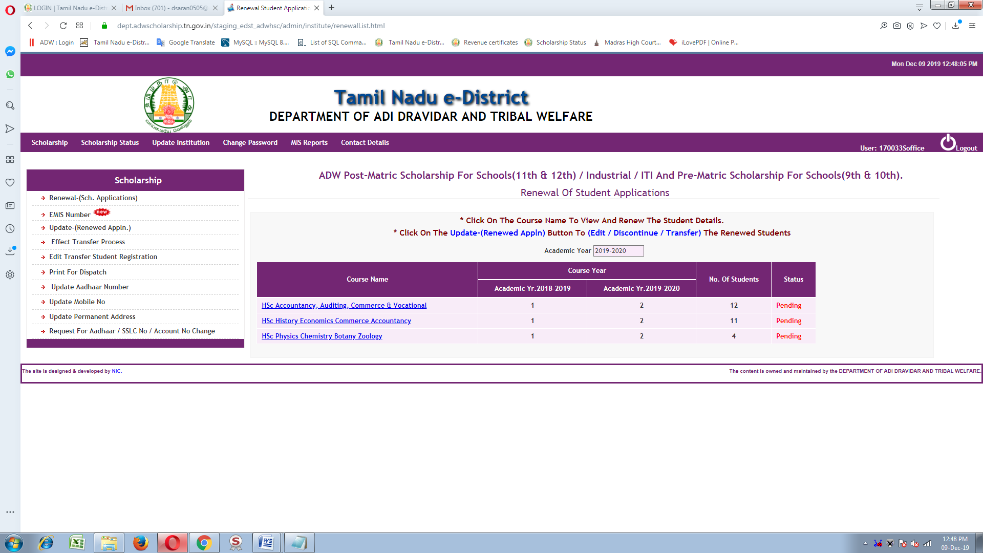
Complete renewal process by Clicking Renewal-(Sch.Applcaitions)
3.1.Click on Course Name.
3.2.Select all and
3.3.Click on Renew button to complete the process.

Slide 6
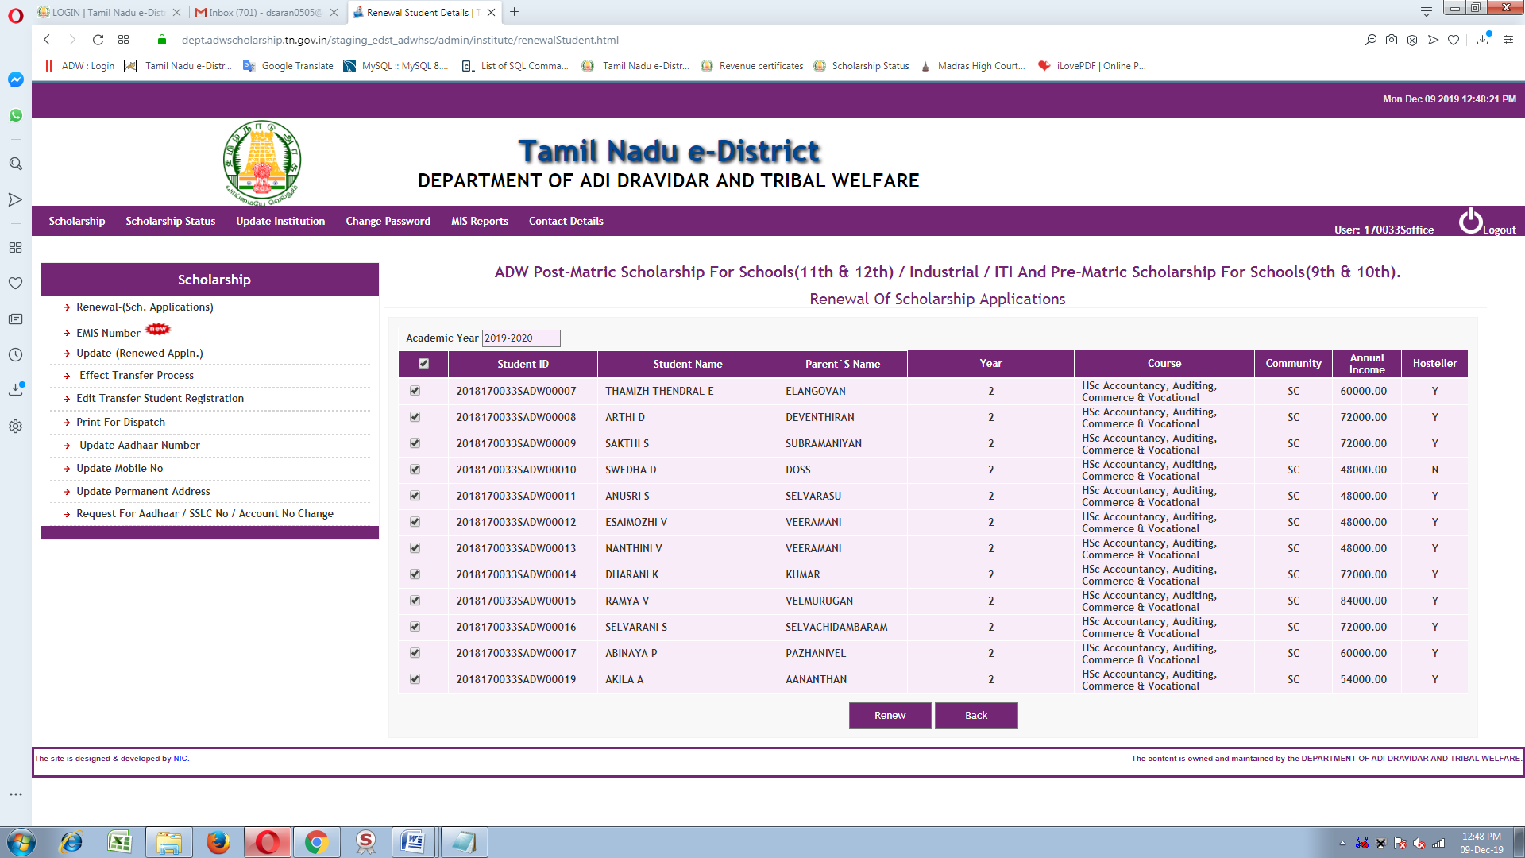

Slide 7
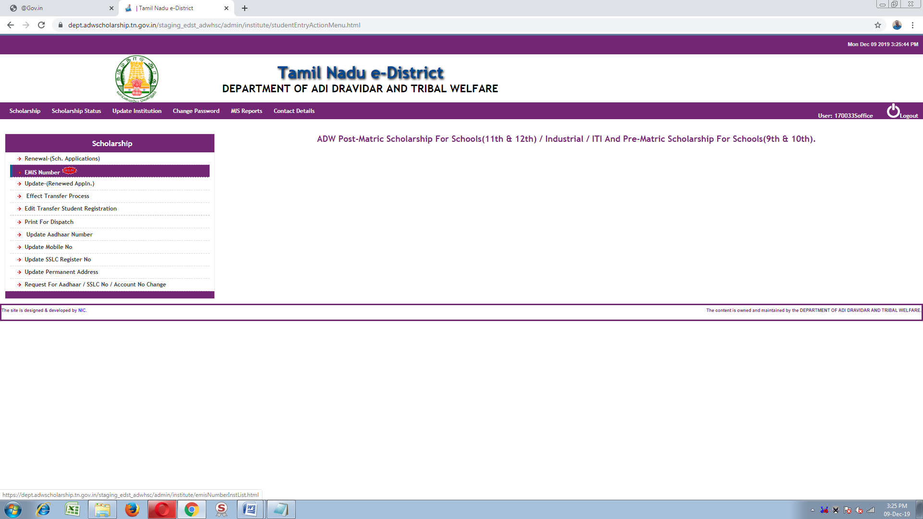
Click on EMIS Number(new)

Slide 8
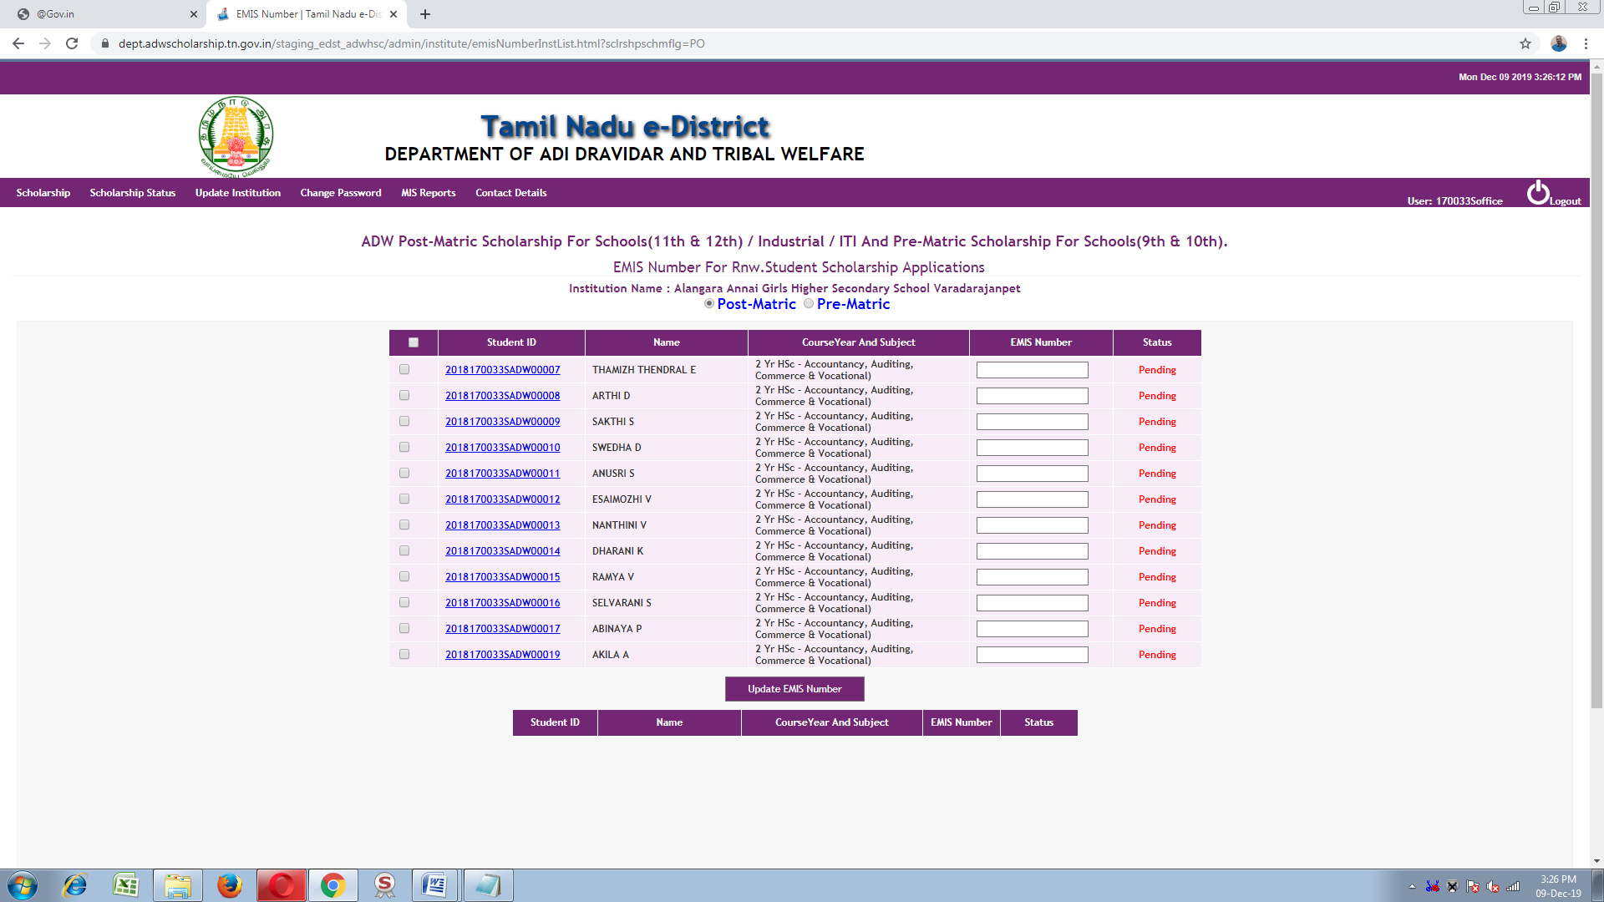
Select Post-Matric or Pre-Matric radio button

Slide 9
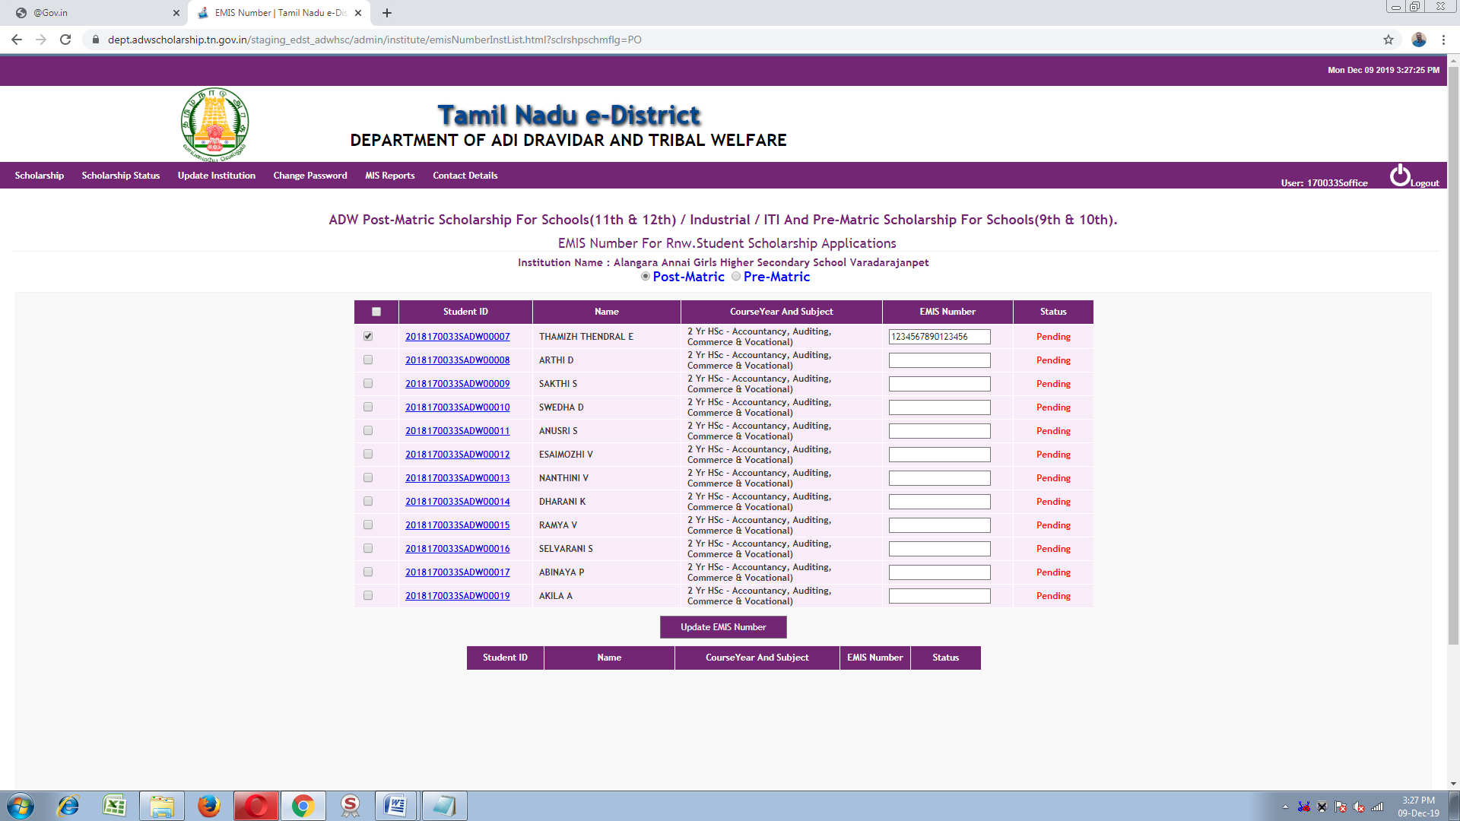
Select the Check box then update the EMIS number for each and evey students one by one by clicking Update EMIS number button

Slide 10
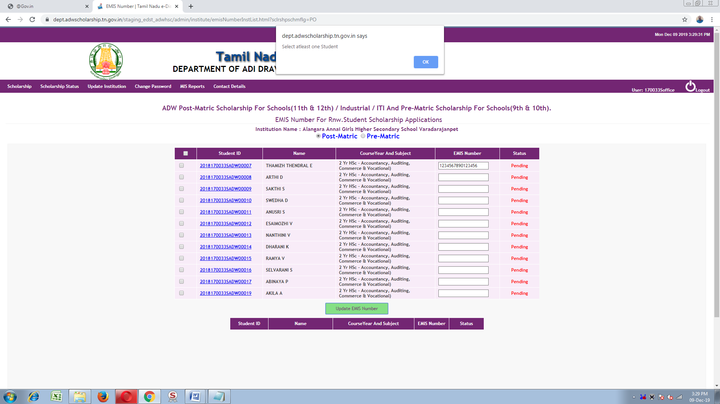

Slide 11
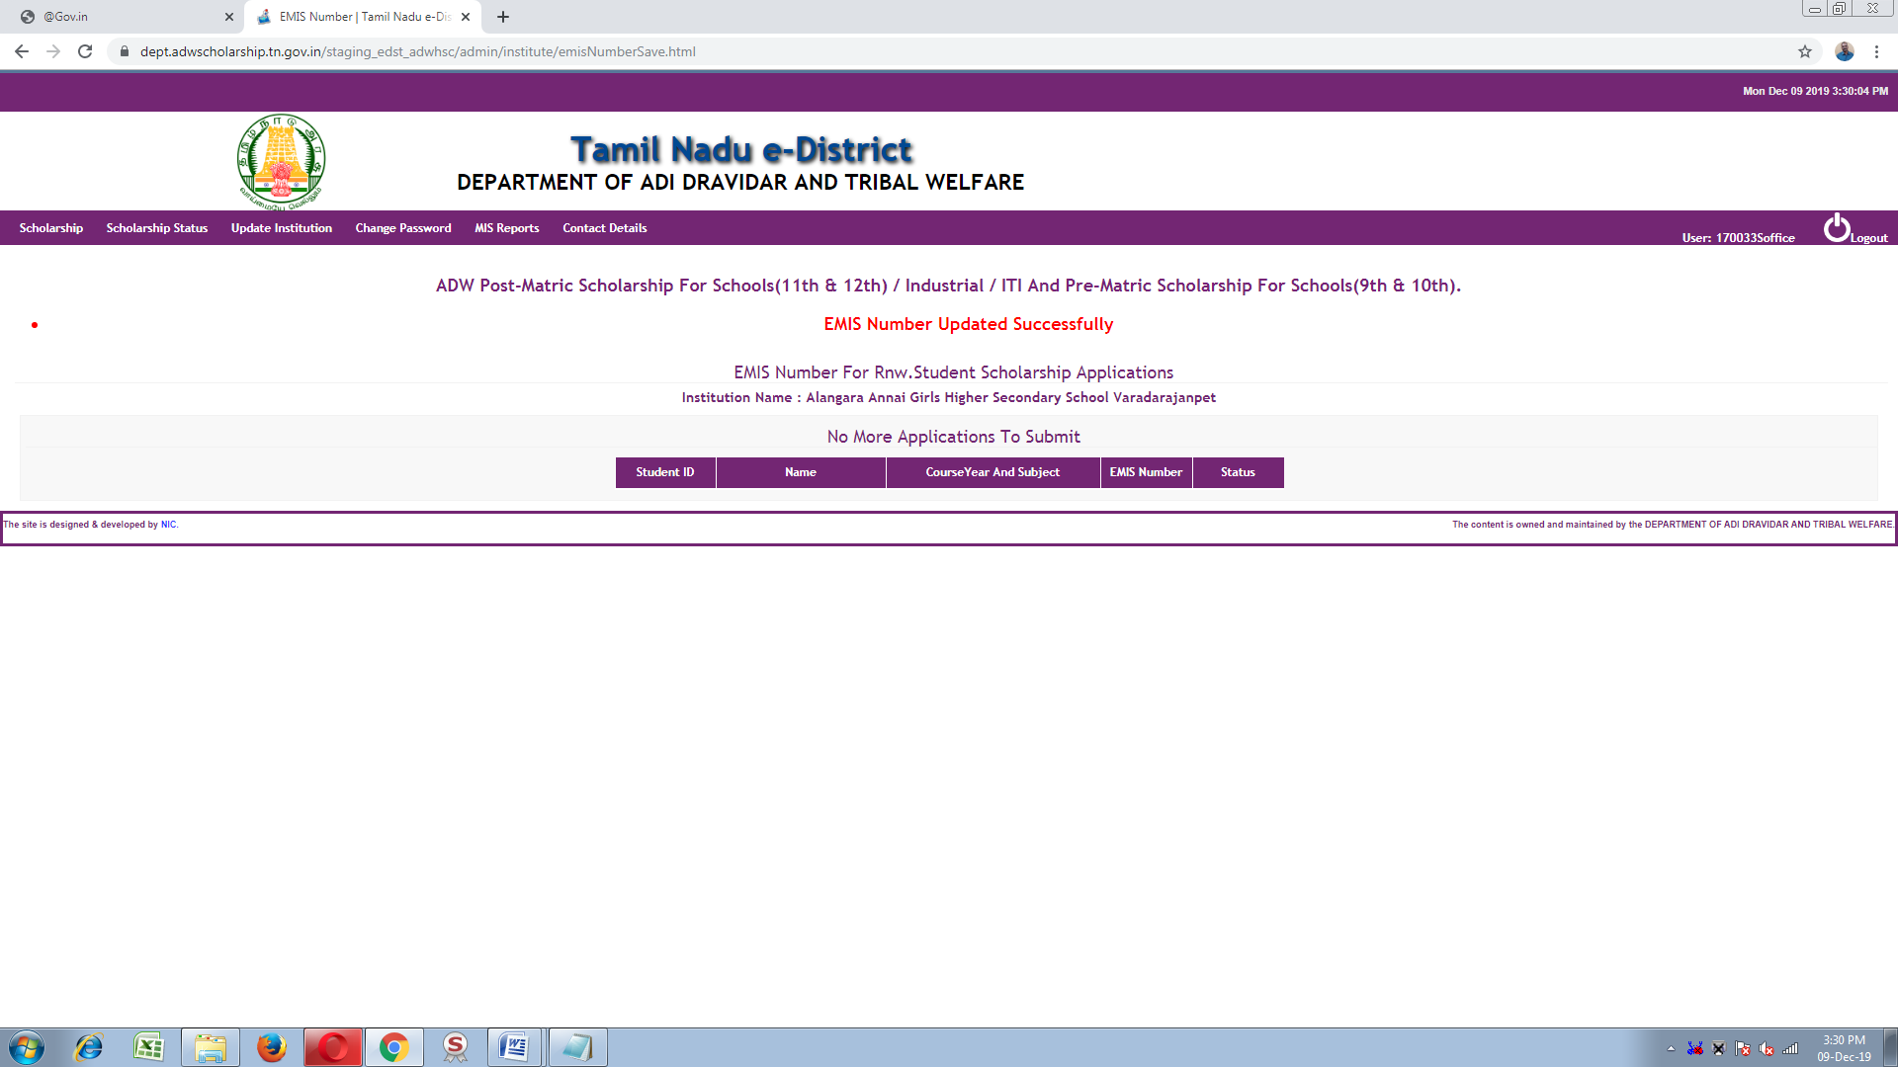

Slide 12
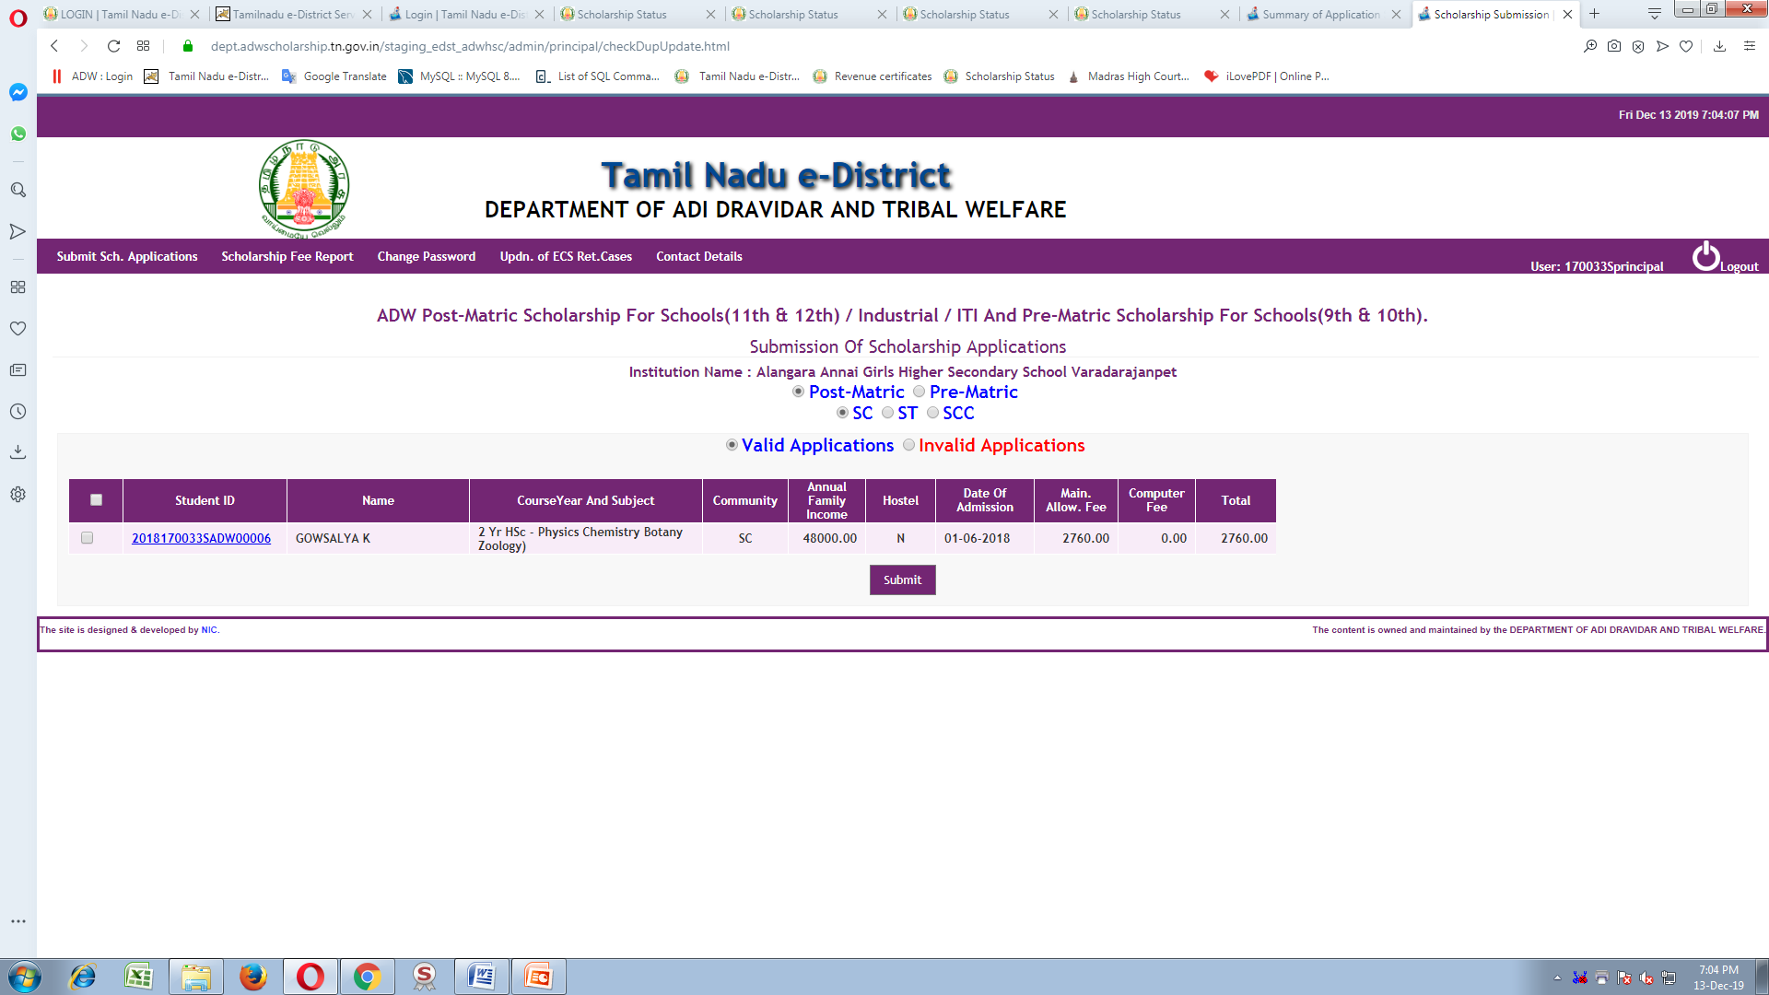
After updation of EMIS number, the students applcaition will be refelected in the “Principal login” for Submit.

Slide 13
Once the EMIS number is updated it can not be changed.
Utmost care should be taken while updating EMIS number.
Thanks

