Slide 1
STUDENT POLICE CADET PROGRAMME (SPCP)
Guidelines for the Implementation of the SPCP

Slide 2
Launch of the SPCP:
At Gurugran- 21.07.2018
Master trainer:
They should train all the trainers
Training to Students:
Students: 8th and 9th Standard
Once a week
For two years

Slide 3
TRAINING PROGRAMME (5 components)
(i)Physical Training –
Outdoor Training- Half a day twice a month
After School Hours or on week end.
(ii)Indoor Training / study classes –
One class per month
(iii)Field visits: Field visits to establishments that administer, implement and adjudicate the law, places of historical, cultural, scientific and national importance
(iv)SPC Camps –
Mini Camp (2 Day camp during vacation)
Annual District Level Summer Camp ( 3 days residential camp)
Annual State-Level Summer Camp ( 5 days residential camp)
(v) Practical training projects: Awareness classes for fellow students on various community issues such as road safety, drug and substance abuse. Environmental protection and aspects of law and crime.

Slide 4
COMMITTEES FORMED:
(as per G.O Ms. No.: 356, Home Modern Dept, dt:29.05.2018)
State level monitoring committee:
Addl. Chief Secretary (Home) – chairman
Addl. Chief Secretary (School Education) – member
DGP – member.
District level monitoring committee:
District Magistrate – chairman
COP / SP – member
DEO / Dy. Ins. Of schools – member.

Slide 5
NODAL OFFICER
State level: ADGP/Training (as per G.O. (ms) no: 1292, home (modern) dept, dt: 03.09.2018) – Already nominated.
District level: Deputy Superintendent of Police in the district and Assistant Commissioner of Police, in City is designated as District / City Nodal Officer – SPC project. [The DNO/CNO (District / City Nodal Officer) has overall executive responsibility for the project implementation, within their jurisdiction. The DNO/CNO will liaise with District / City level officials, coordinate with officials from other departments and report regularly to the District / City Advisory Committee on a regular basis]. – To Be Nominated.

Slide 6
UNIFORM
Official- Khaki pant & Khaki Shirt.
Physical Training - White T-Shirt & Blue Pant.

Slide 7
SCHOOL LEVEL ADVISORY COMMITTEE:
Principal or Head Master as Chairman
Jurisdiction Inspector of Police as Convener
President of Parent-Teacher Association
Local representatives from Education, Forest, Enforcement & NIBCID
Transport departments
Sub-Inspector / Special Sub-Inspector as Committee Secretary

Slide 8
Coverage:
First instance be implemented in Government schools.
These schools could be in Urban / Municipal areas or in Rural / Panchayat areas.
Selection of Students:
First year cadets are called Junior Cadets and Second year cadets are called Senior Cadets.
Strength:
The strength of each batch will be 44 cadets i.e. two platoons of 1+21 each.
In case of co-educational schools (with both Boys and Girls), one platoon must be of girls only.

Slide 9
APPOINTMENT OF CPO/ACPO:
In each school, two dedicated and service-minded teachers will be selected as Community Police Officer (CPO) / Additional Community Police Officer (ACPO) with responsibility for implementing the SPC programme in the school.
Teachers from any discipline may be appointed as CPOs.

Slide 10
APPOINTMENT OF DRILL INSTRUCTORS
In each school, two trained police personnel need to be assigned to function as Drill Instructors, entrusted with the task of training the SPCs.
The DIs are police personnel attached to the local Police Station or AR wing, and will undergo special training for the SPC project.

Slide 11
ASSESSMENT & EVALUATION
At the end of the two-year training programme, all cadets will undergo a series of tests, including physical, written and skill-based components. On the basis of the performance in such tests, each SPC will be awarded grades appropriate to his/her level of proficiency. At the end of the programme the participating students can be awarded an SPC Certificate.
An evaluation of the implementation of the Programme through an external agency one year after its operationalization would be conducted by the Union Government

Slide 12
TRAINING FOR CPOs & ACPOs
5 day residential training course for CPOs (Community Police officer- Teacher) and ACPOs (Additional Community Police officer – Teacher).
In this training programme teachers are facilitated to acquire fitness and develop positive traits.
It is advisable to conduct such training at a centrally located Police Training Facility for CPOs/ACPOs from all over the District / City.

Slide 13
TRAINING FOR DRILL INSTRUCTORS
The basic course for Drill Instructors is a 3-days residential training programme
(ii) It is meant to orient police personnel as educators of high school students.

Slide 14
ORIENTATION COURSE
One day training programme
To explain the aims, objectives and other details of SPC Project are to be organized
Participants:
  District Nodal Officers
  Addl. District Nodal Officers,
  Student Police Liaison Officers (Inspector),
  SHOs,
  Drill Instructors,
  Community Police Officers,
  Heads of Education institutions which is selected for implementing SPC Project
  District level officers
  Forest
  Enforcement & NIBCID,
  Transport,
  Fire force and Local Self Government.

Slide 15
REFRESHER COURSE
Every year, Refresher training courses for various categories of officials are conducted.
Two-day Programme for District Nodal Officer, PSLOs (Police Student Liaison officer - Inspector of Police/SI/SHO), SHOs (Station House officer) and Heads of Educational Institutions, Drill Instructors, and
Three-days residential programme for CPOs (Community Police officer- Teacher) and ACPOs (Additional Community Police Officer- Teacher).

Slide 16
IDENTIFICATION OF SCHOOLS
&
SOURCE OF FUNDS FOR THE IMPLEMENTATION OF THE PROGRAMME
Funds sanctioned as per G.O. (Ms.) No.1292, Home (Modern) Department, dated:03.09.2018 for the implementation of SPCP in Tamil Nadu
Sl. No | Year | Funds allotted (Total) (in Rs.) | Funds allotted per school (in Rs.)
1) | 2016-2017 | 3,08,00,000 | 50,000 *
2) | 2017-2018 | 4,12,45,000 | 50,000 *
* As per the para 4 of Guidelines for implementation of SPC Programme issued vide letter No.VI.21011/51/2016-PM-I, dated:31.03.2017, where it has been stated that an allotment amount of Rs.50,000/- per annum may be made to each school.

Slide 17
FUNDS TO SCHOOLS
An allotment of Rs. 50,000/- per annum is provided made to each school.
Out of this amount,
  A sum Rs.16,000/- may be earmarked for teaching aids,
  Another Rs. 24,000/- for outdoor activities.
  Rs. 5,000/- for training and
  Rs. 5,000/- for Contingency.

Slide 18
MASTER TRAINERS (PROPOSED BY CHIEF OFFICE FOR TRAINING THE SPCP PERSONNEL –
(TRAINING IS YET TO BE COMMENCED)
S.No. | Name of the Departments | Details of officer nominated for Master Trainers
1. | Tamil Nadu Police Academy | Name: Tr. M. Ramasubramanian Designation: Deputy Superintendent of Police, (Retd), Place: Tamil Nadu Police Academy, Chennai-127. Phone No: 9498103510
2. | Education Department | Name: Tr. S. Pasupathy, Designation: B.T., Asst (Maths), Place: Govt. Hr. School, MMDA Colony, Arumbakkam, Chennai-106. Phone No: 9444207278
3. | Sports authority of Tamil Nadu | Name: Tr. A. Rajan, (Contract), Designation: Athletic Coach, Place: Jawaharlal Nehru Stadium, Chennai-3, Sport Hostal of Excellence (Boys). Phone No: 9444136735
4. | Transport Department | Name: Tr. P. Jeyabaskaran, B.E., M.B.A., Designation: Regional Transport officer, Place: Tiruvallur (Regional Transport office) Phone: 044-27663333
5. | Fire & Rescue Services | Name: Tr. V. Elumalai, B.Sc (Chema) M.A (Public Admin) Designation: Lecturer/ Assistant District officer, Place: State Training Centre, Tambaram, Chennai- 47. Phone. No: 9445086007.

Slide 19
FUNDS TO BE DISTRIBUTED BY CHIEF OFFICE FOR THE IMPLEMENTATION OF SPCP (2017-2018)
Sl. No | Name of the Commissionerate/ District | Fund to be allotted to each Commissionerate/ Districts for implementing SPCP (in Rs.)
1) | Chennai City | 1,38,00,000
2) | Kancheepuram District | 1,37,00,000
3) | Thiruvallur District | 1,37,00,000
Sub-total |  | 4,12,00,000
SPC / State Nodal Officers Secretariat Contingency |  | 45,000
Grand Total |  | 4,12,45,000

Slide 20
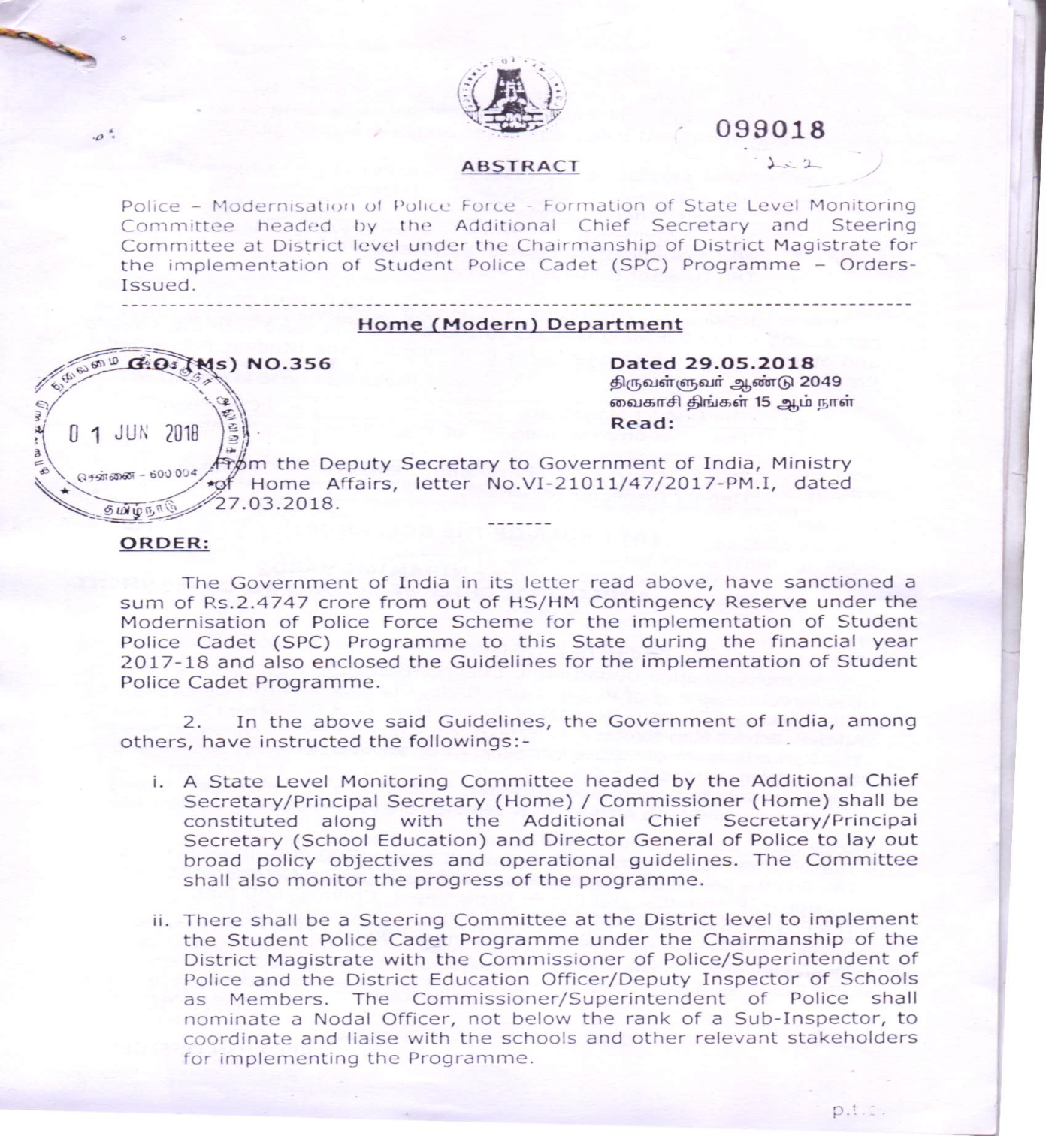
FORMATION OF COMMITTEE (SPCP)

Slide 21
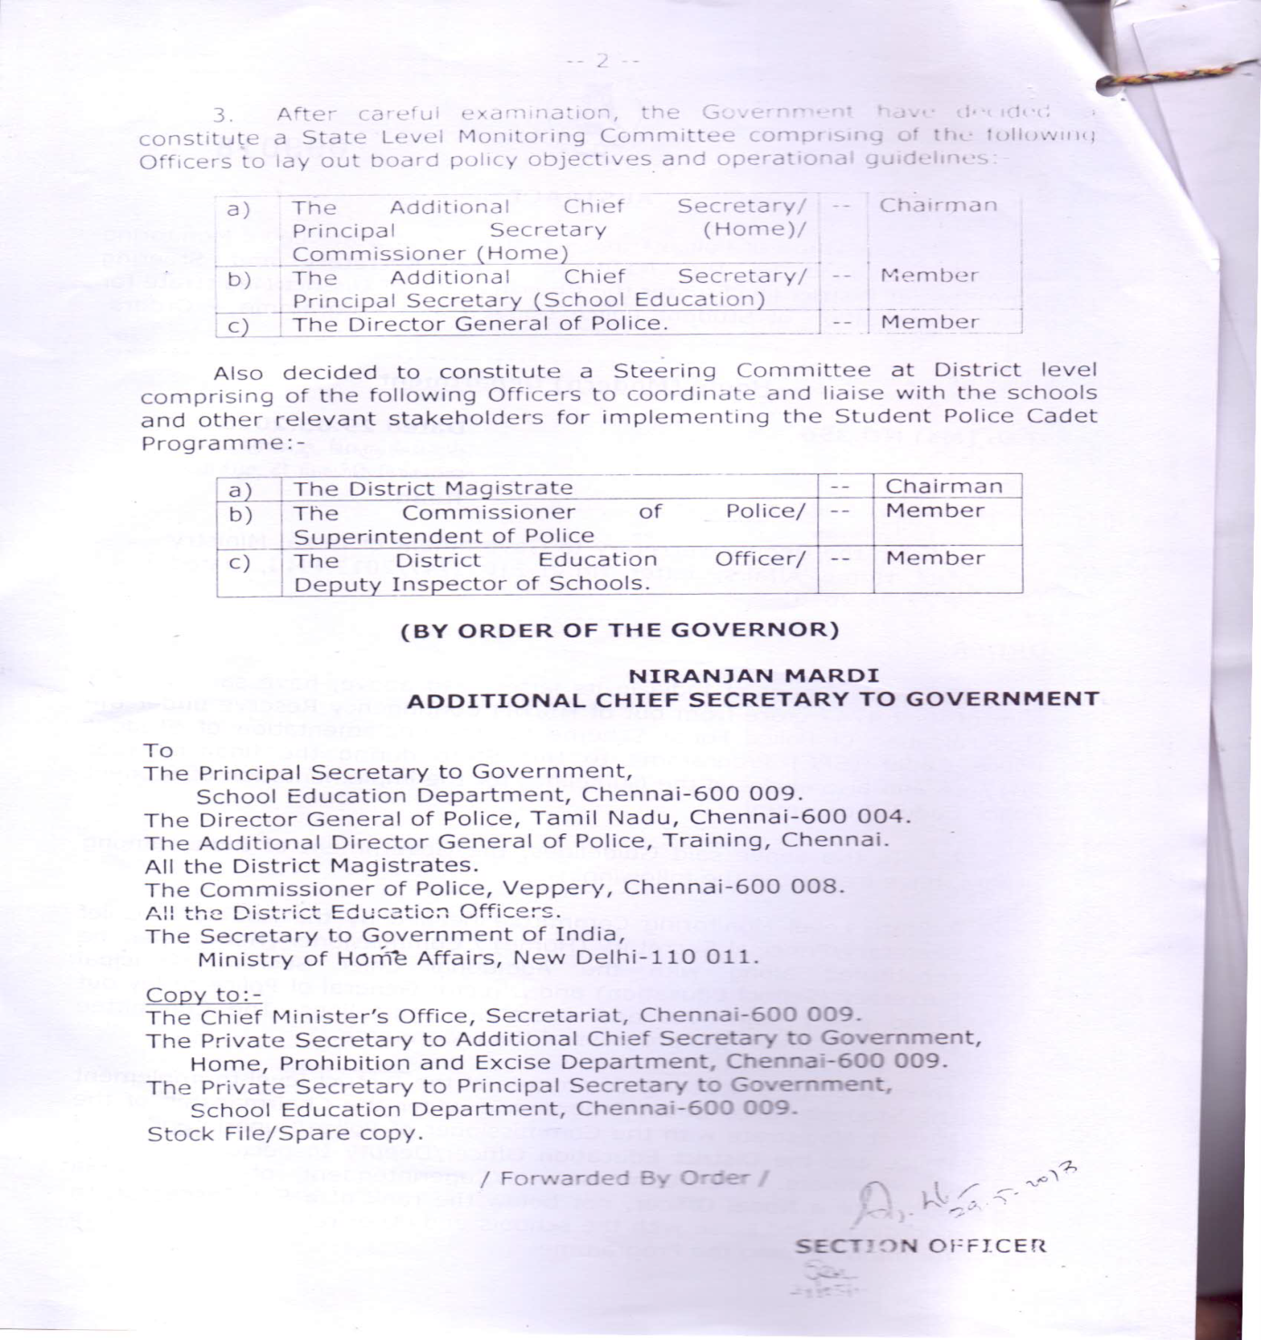
-2-

Slide 22
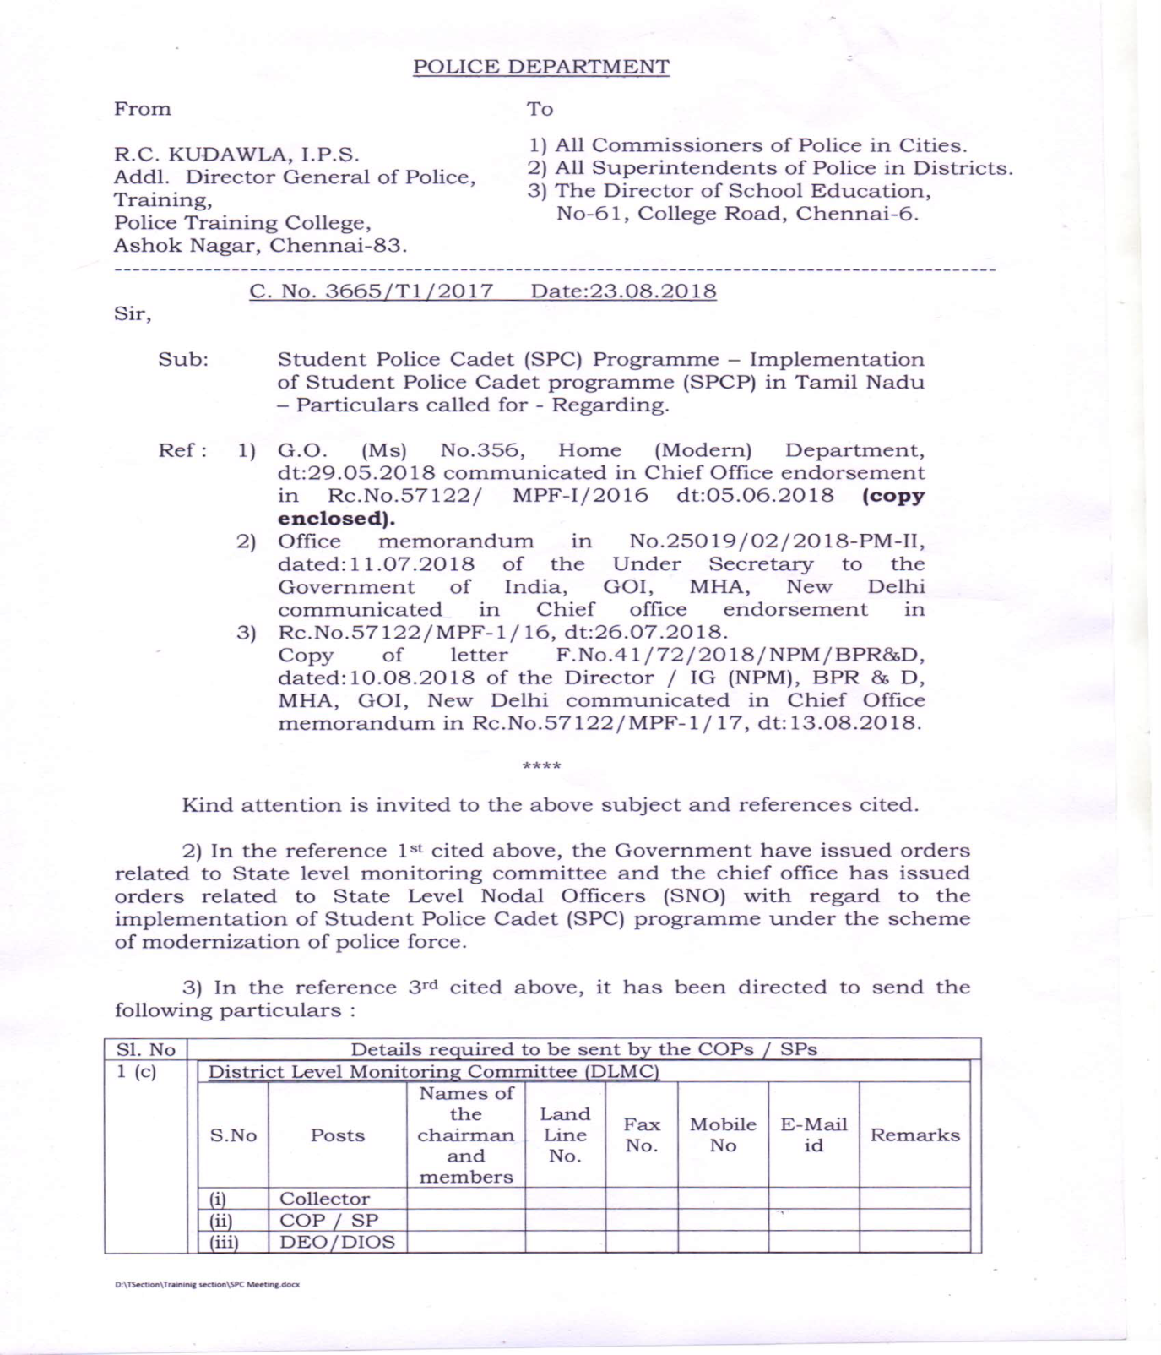
LETTER ADDRESSED TO ALL UNIT OFFICERS - CALLING FOR PARTICULARS RELATED TO SPCP IN THE BPR&D FORMAT

Slide 23
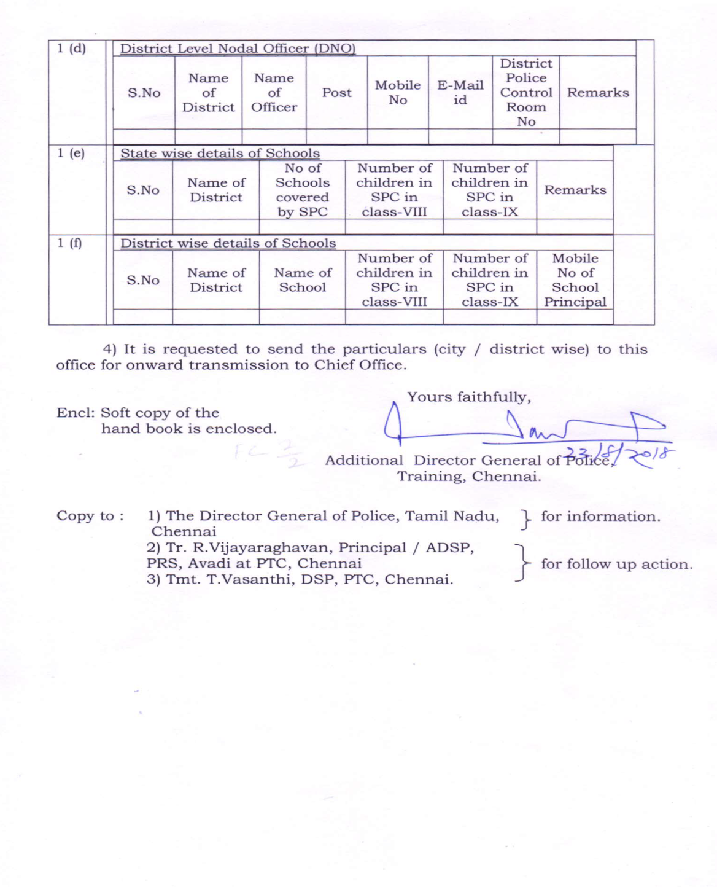
-2-

Slide 24
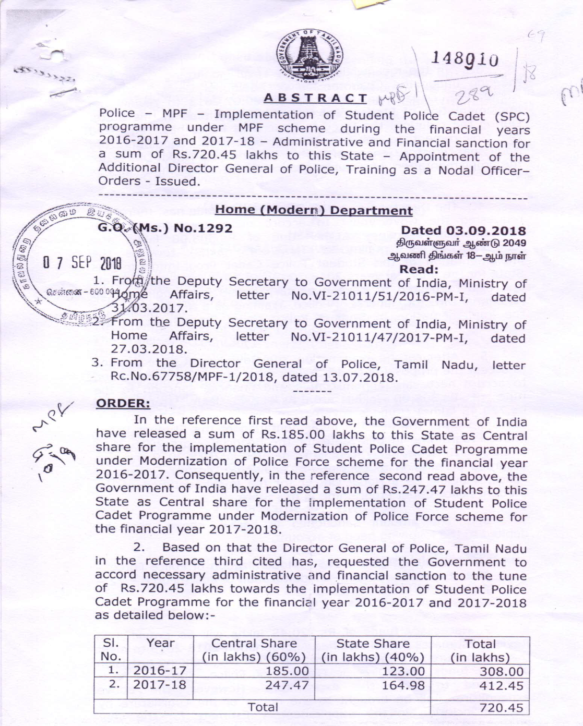
FINANCIAL SANCTION G.O FOR THE IMPLEMENTATION FOR SPCP UNDER MPF SCHEME FOR THE YEARS 2016-17 & 2017-18

Slide 25
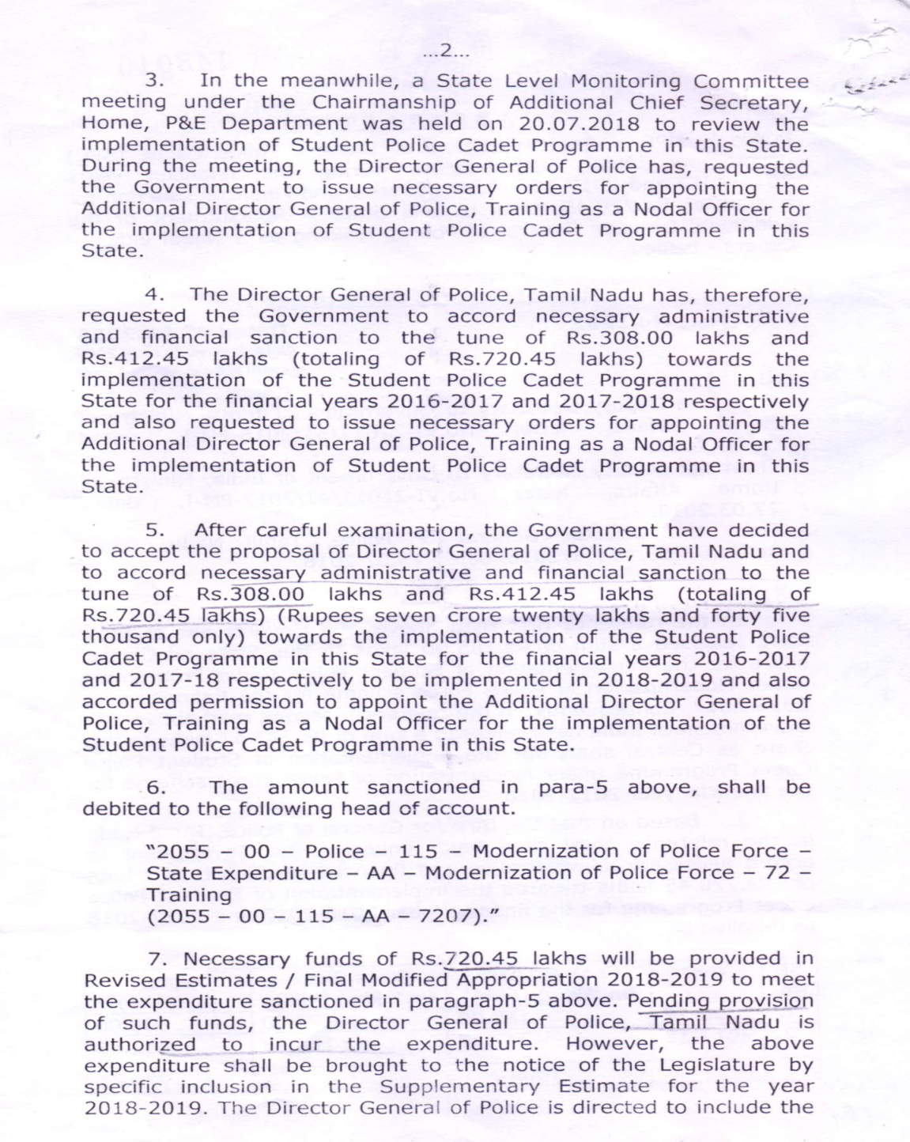
-2-

Slide 26
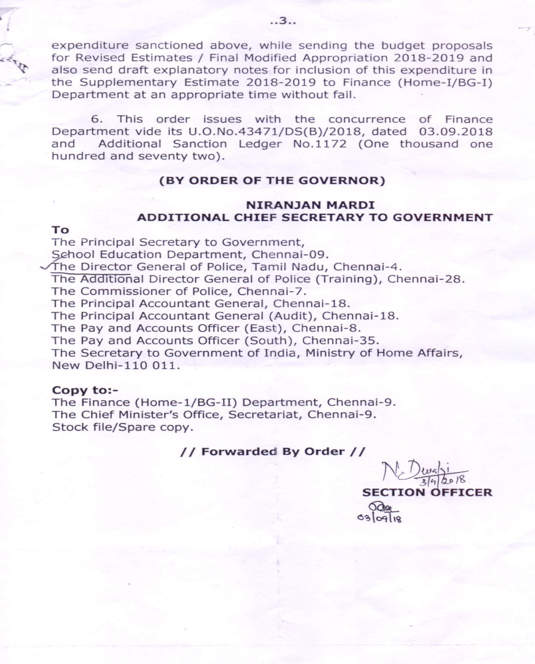
- 3 -

Slide 27
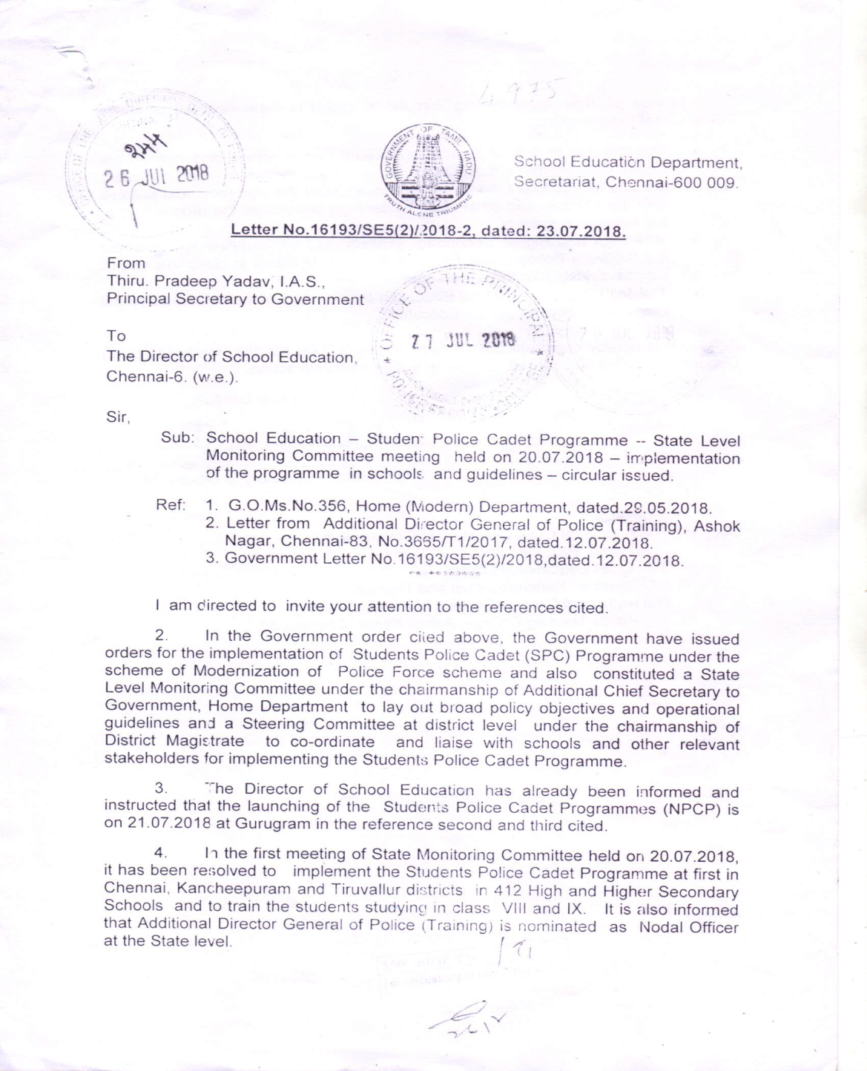
GOVERNMENT LETTER RELATED TO IDENTIFICATION OF 412 HIGH AND HIGHER SECONDARY SCHOOLS AT CHENNAI CITY, KANCHEEPURAM & THIRUVALLUR DISTRICT

Slide 28
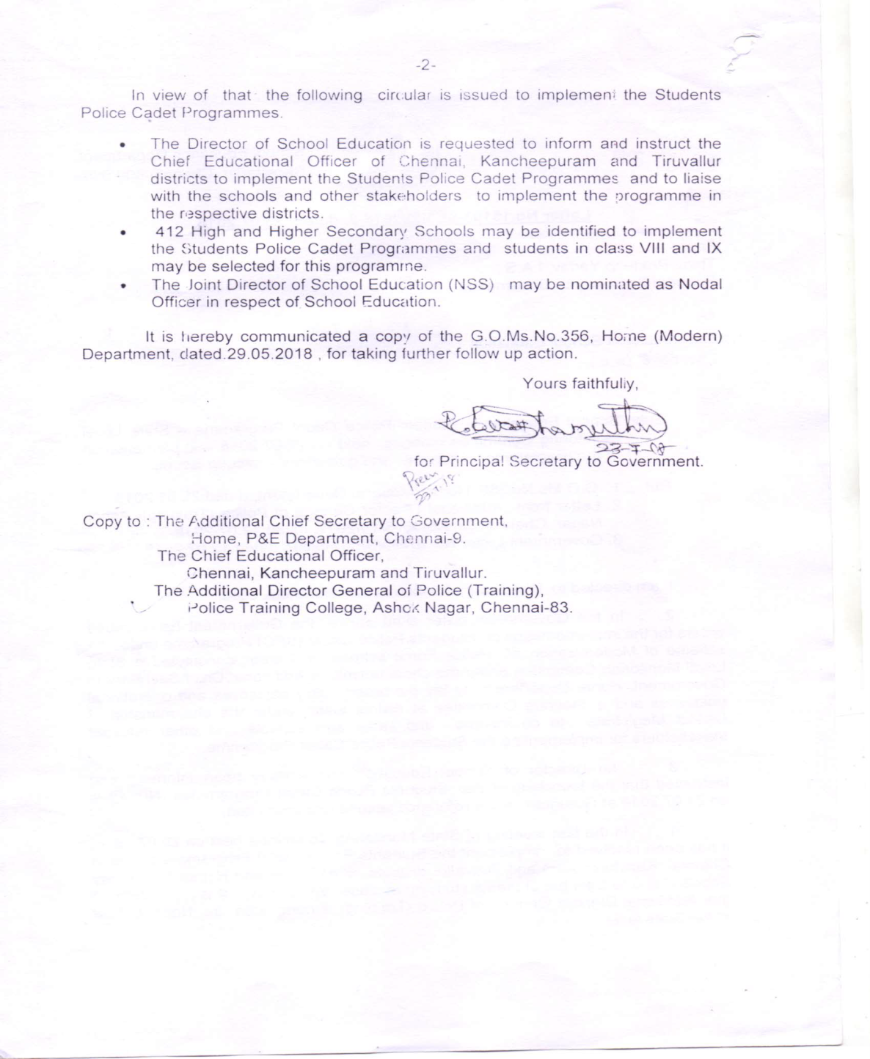
-2-

Slide 29


